Slide 1
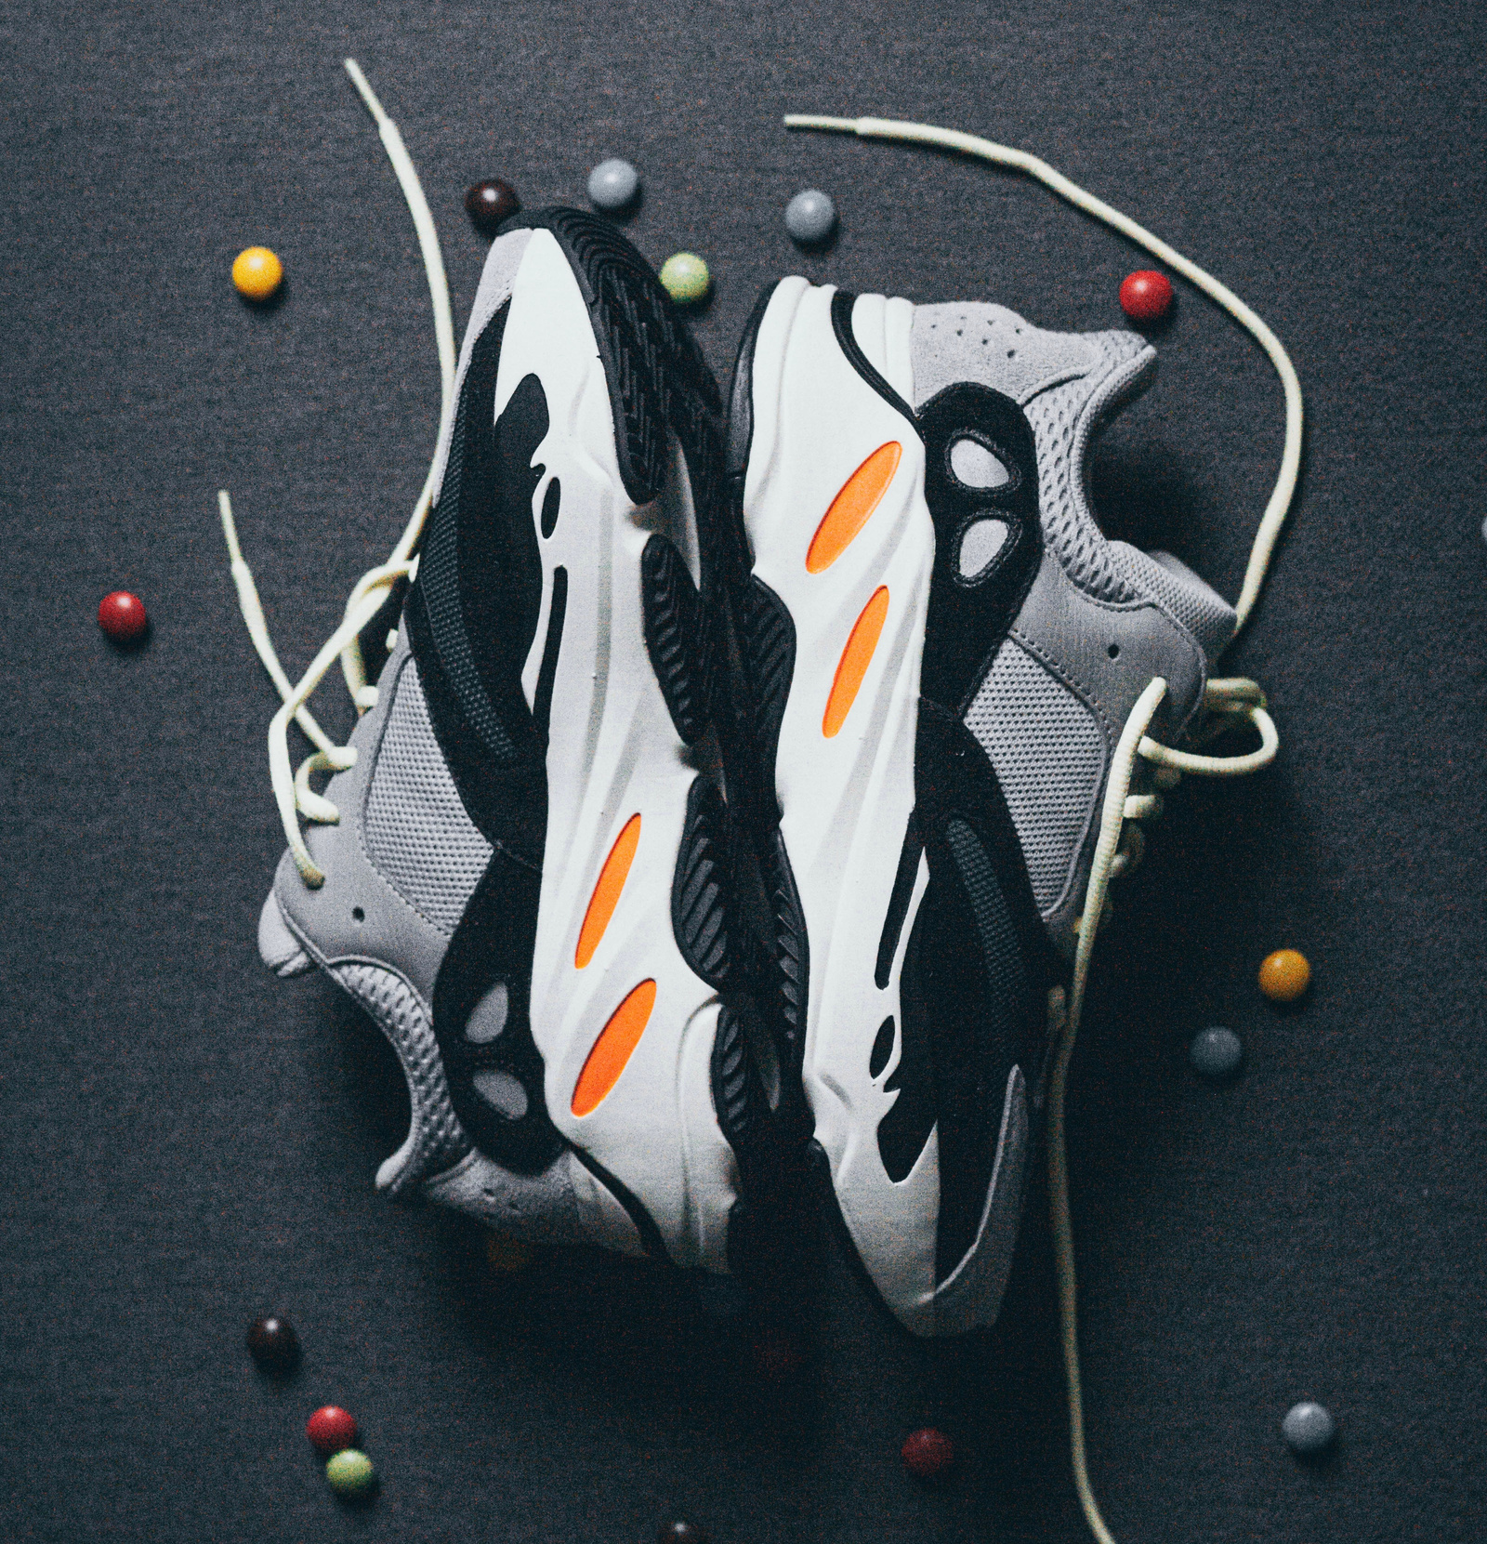


ADIDAS SALES PERFORMANCE ANALYSIS
Presented by: GROUP 8
Program: BeTechified DA July'26

Slide 2
Objectives & Methodology
Project Objectives
Methodology
Analyse profitability across products
Microsoft Excel PivotTables, PivotCharts, slicers, and KPI cards were used to summarize and visualize the Adidas sales dataset.
Compare retailer performance
Evaluate regional profitability
Data Cleaning Process
Removed duplicate records
Analyse monthly sales trends
Checked for missing values
Provide recommendations to improve profitability
Standardized date formats
Verified numeric fields
Built PivotTables for the dashboard
Adidas Sales Analysis | Board Presentation
3

Slide 3
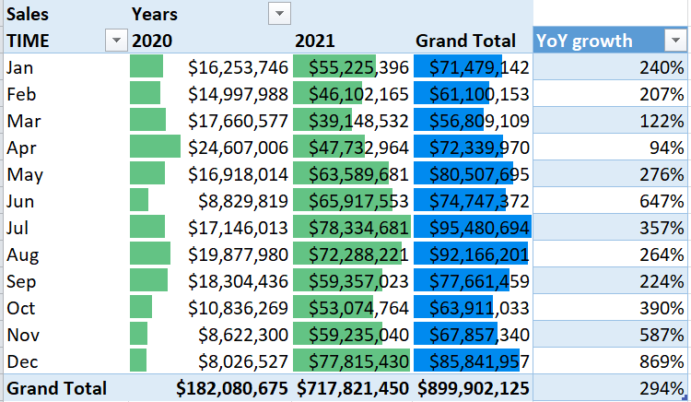
SALES OVERVIEW
Total sales surged from $182.08M in 2020 to $717.82M in 2021, marking an impressive YoY growth of approximately 294%.

Slide 4
MONTHLY SALES HIGHLIGHTS
HIGHEST SALES
LOWEST SALES
YOY GROWTH
July marked the peak sales month.
March recorded the lowest sales figures.
December saw exceptional year-over-year growth.

Slide 5
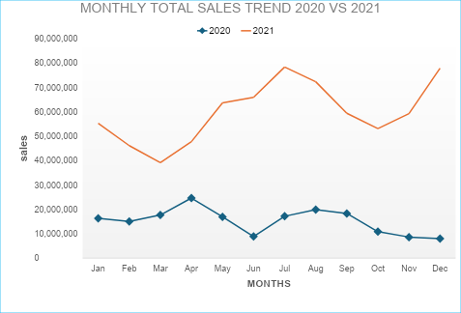

Slide 6
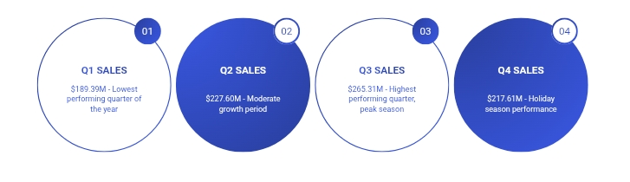
QUARTERLY SALES PERFORMANCE

Slide 7
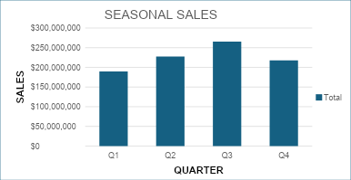

Slide 8
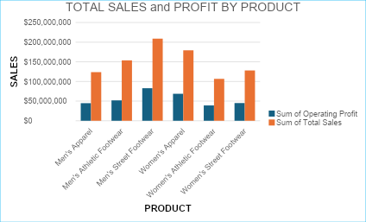
PRODUCT CATEGORY PERFORMANCE
KEY SALES INSIGHTS OVERVIEW
Men's Street Footwear: $208.83M sales
Women's Apparel: $179.04M sales
Men's Athletic Footwear: $153.67M sales
Lowest Margin: Women's Athletic Footwear

Slide 9
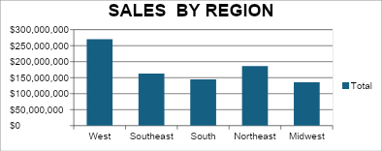
REGIONAL SALES PERFORMANCE
DISTRIBUTION OF TOTAL SALES BY REGION
West region leads sales
Northeast shows strong performance
Midwest region is lowest
Southeast sales are significant

Slide 10
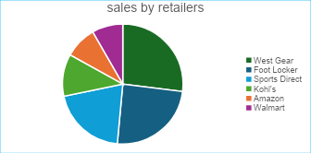
RETAILER PERFORMANCE RANKING
West Gear leads sales revenue
Foot Locker ranks second overall
Sports Direct shows strong performance
Walmart ranks lowest in sales

Slide 11
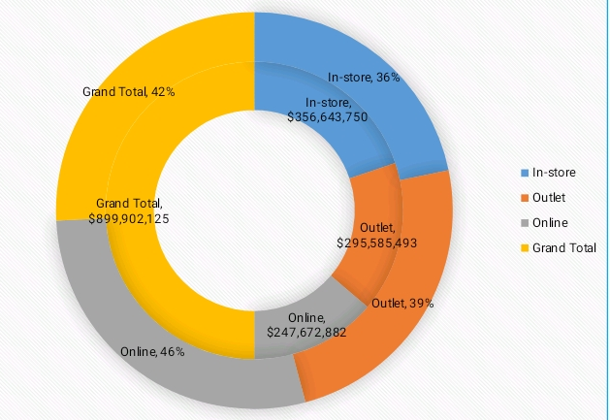
SALES CHANNEL PERFORMANCE
OVERVIEW OF REVENUE AND MARGINS
In-store sales generate highest revenue
Online channel offers best margin
Outlet performance remains strong
Diverse channels drive overall growth

Slide 12
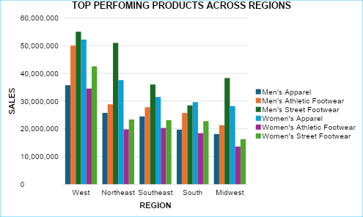
PRODUCT PERFORMANCE ACROSS REGIONS
Men's Street Footwear shows strong performance across most regions, while Women's Athletic Footwear presents a growth opportunity for future sales.

Slide 13
RECOMMENDATIONS: PRODUCT STRATEGY
01
MEN'S FOOTWEAR
INCREASE INVESTMENT IN MEN'S STREET FOOTWEAR TO CAPITALIZE ON ITS STRONG SALES PERFORMANCE AND ENSURE IT REMAINS A TOP PRODUCT FOR FUTURE GROWTH.
02
WOMEN'S FOOTWEAR
Review and improve Women's Athletic Footwear offerings, identifying gaps in the market to enhance sales and capture untapped customer segments.

Slide 14
REGIONAL FOCUS STRATEGIES
01
INVENTORY MANAGEMENT
Maintain stock levels in West and Northeast regions consistently.
02
MARKETING STRENGTHENING
Enhance promotional efforts in the Midwest and South markets.
03
PARTNERSHIP DEVELOPMENT
Build stronger relationships with key regional retailers for growth.

Slide 15
RETAILER MANAGEMENT STRATEGIES
01
PARTNERSHIPS
Strengthen partnerships with West Gear and Foot Locker.
02
PROMOTIONS
Target promotions for Walmart and Amazon to boost sales.
03
ENGAGEMENT
Enhance retailer engagement through collaborative marketing initiatives.

Slide 16
RECOMMENDATIONS: CHANNEL OPTIMIZATION
01
DIGITAL MARKETING
Increase targeted ads to boost online shopping engagement.
02
E-COMMERCE PROMOTIONS
Expand promotional offers to encourage online purchasing behavior.
03
OUTLET OPERATIONS
Continue operations to enhance brand visibility and sales.

Slide 17
TIME-BASED RECOMMENDATIONS
01
INVENTORY BOOST
Increase stock levels before peak sales periods in Q3.
02
MARKETING STIMULUS
Launch targeted promotions to stimulate demand in Q1.
03
SEASONAL PLANNING
Prepare marketing strategies ahead of July’s high sales.

Slide 18
THANK YOU.

